Slide 1
Why Our Compony Must
Weöceodyfveledfögüö—novvreiuluMocKiepcofl
PREPARED BY KAMAL HOS SAIN, HU MAYUN, SANDIL AZAD

Slide 2
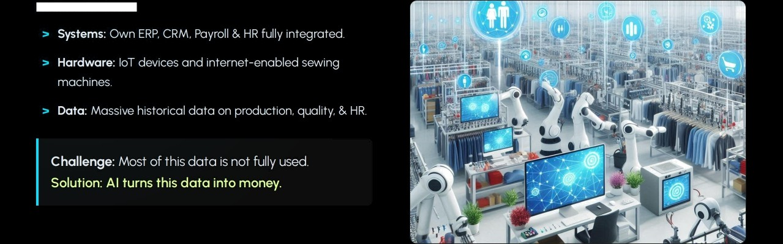
Digital Foundation to Profit
We Hove the Assets:

Slide 3



Profit & Cost: Direct Business Impact
Higher Productivity
Lower Quality Cost
Less Downtime
AI detects low-efficiency lines in real
Finds patterns in defects by style and
Machine data + AI predicts
time. Even 3—5% efficiency gain equals
fabric. Predicts problems early, leading
breakdowns before they happen. Plan
massive overtime and cost savings at
to less rework and fewer rejections.
maintenance smartly for stable output.
our scale.

Slide 4
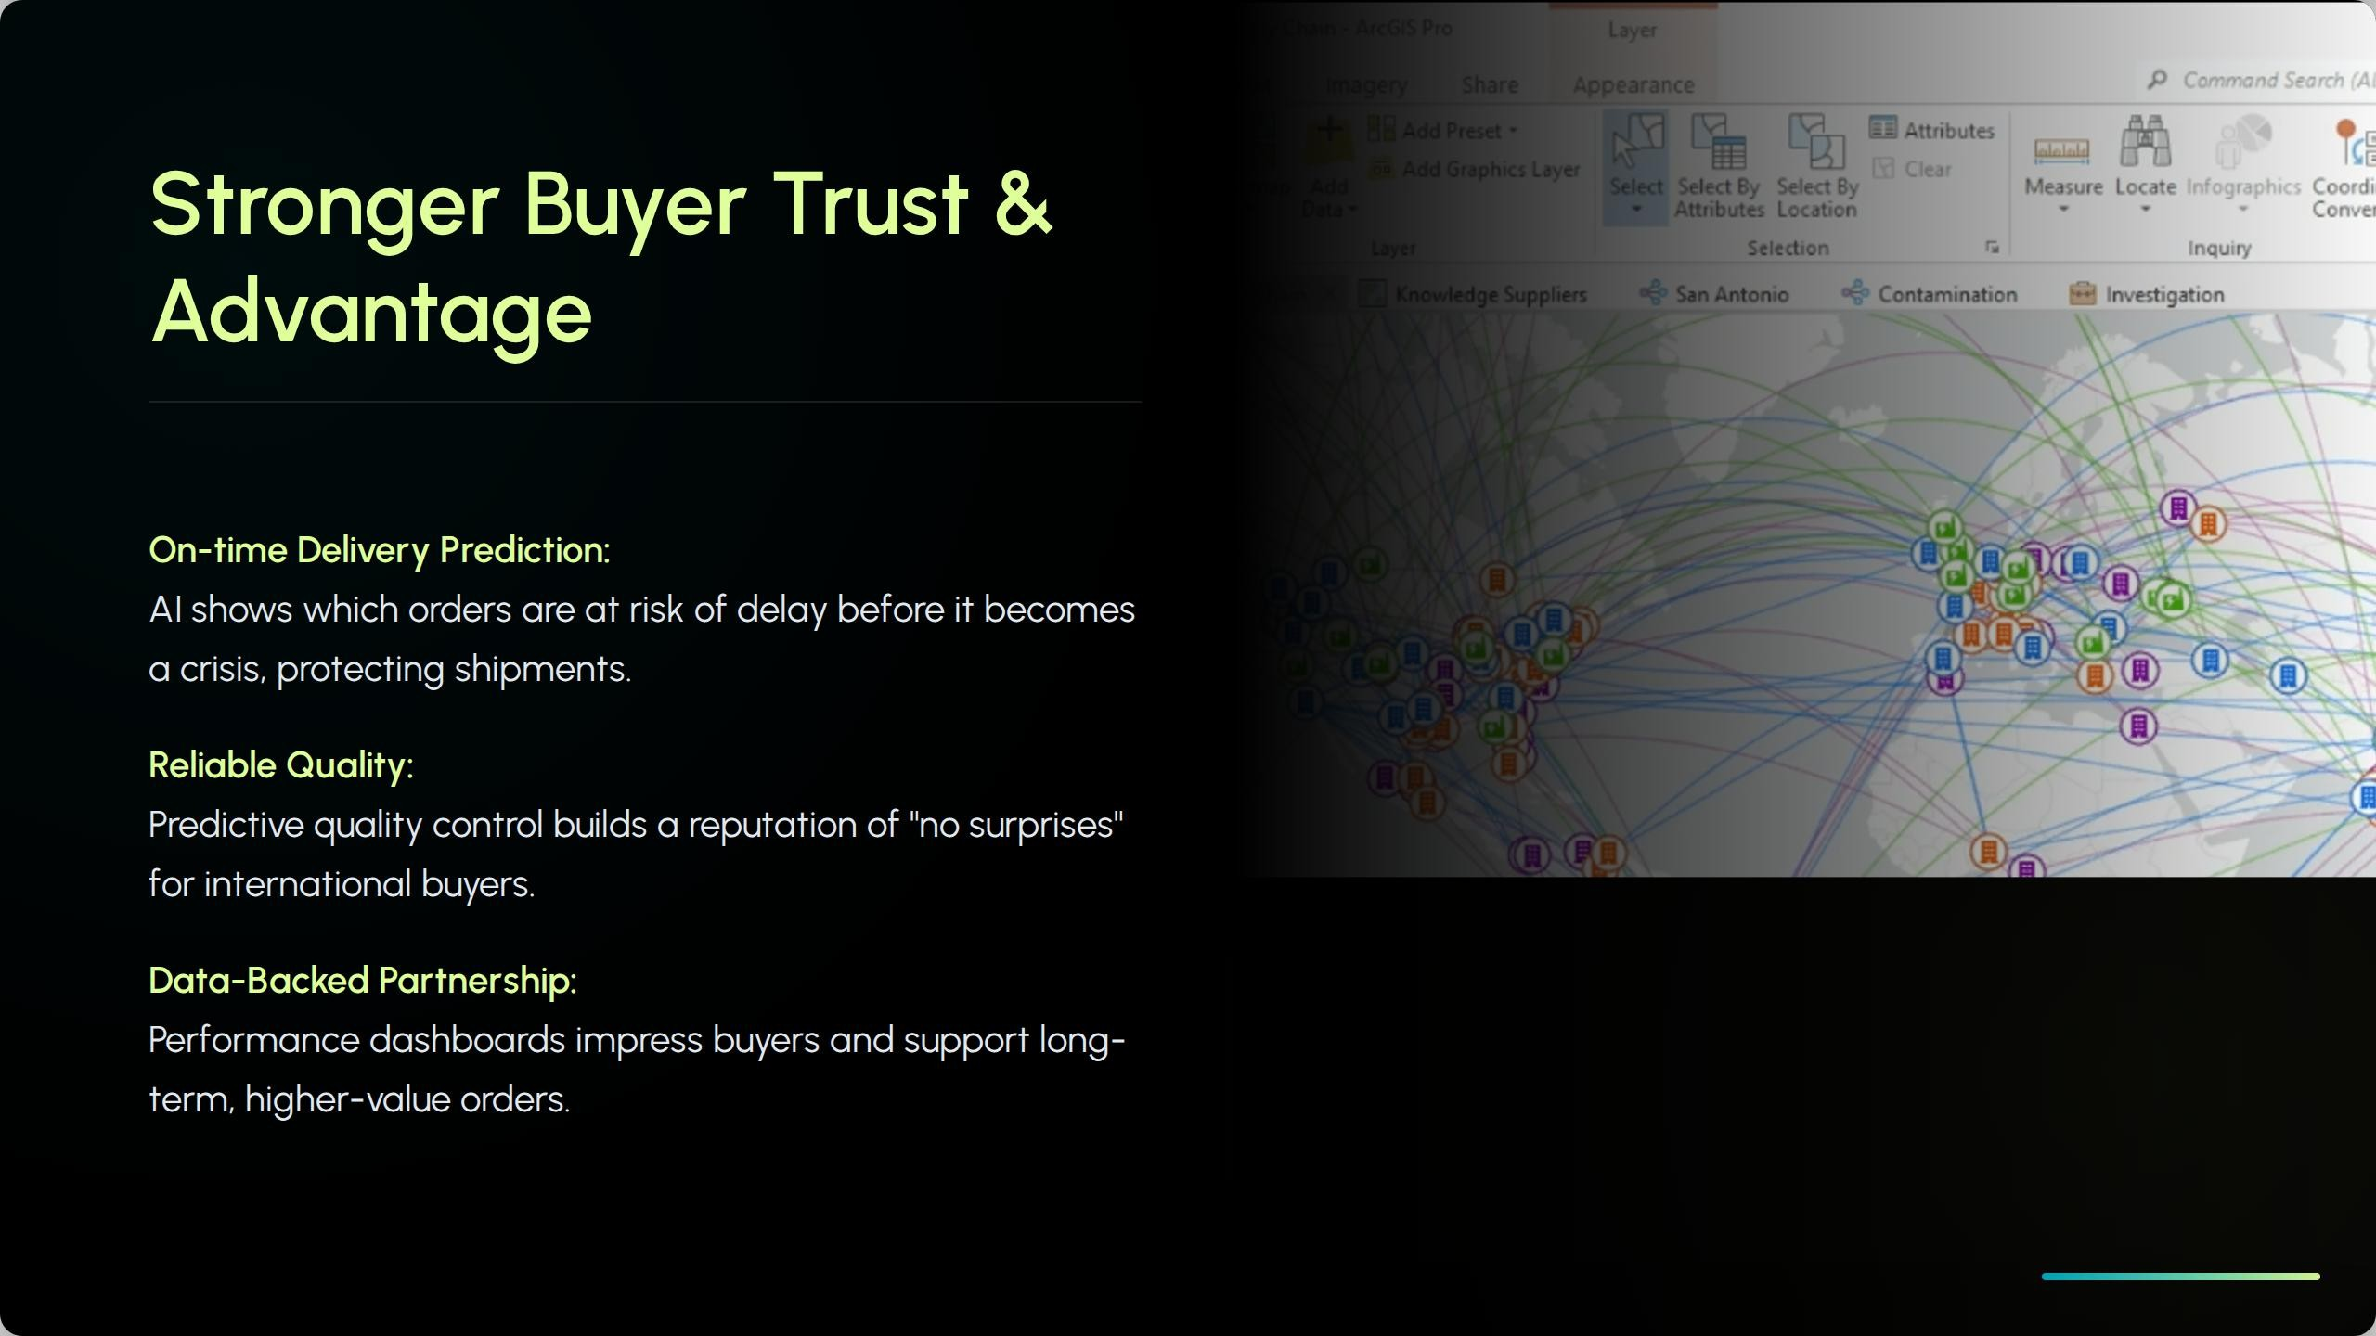

Slide 5
Smarter Operations & Planning
Benefits for Employees
Smarter Planning
» Demand: AI forecasts demand by season and
» Buying: Predicts realistic fabric needs, reducing dead sfock
» Allocation: AI predicfs local market trends for higher sell-through.
» Less last-minute firefighting, more planned work.
» Better fools (dashboards) fo manage lines.
» Clear performance visibility supports fair recognition and career growth.
stye.

Slide 6

Digifol Base is Ready:
We have the ERP & IoT infrastructure; we only need to add
AI.
Morkef Shiff:
Leading RMG factories are already adopting analytics
Low Risk. High Refurn:
Start with one pilot, scale only when results are proven.
Fufure-Proofing:
Secures our market position for the next 10—15 years

Slide 7
The Proposal
Start a 3—ó month AI pilot using our existing data to improve efficiency and quality, then scale successful models.
Objective: Maximize output, minimize waste.

Slide 8
Ready to unlock the future of manufacturing?
Prepared by. Kamal Hossain, Humayun, Sandil Azad
www.yourcompany.com | contact@yourcompany.com

Slide 9

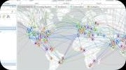


Image Sources
https://cdn shopify com/s/ftles/)/0044/)SS2/0842/files/A_modern_porment_foctory_with_interconnected_mochines_AI_robots_ond_smort_devices_workinp_seomlessly_)024x)02
Thumbnail 4.jpg8v=)73)S600S)
for
Source.
everlighten.com
https://www esri.com/orcgis-blog/wp-content/uploads/2022/04/Picture).png
Source.
https://png pngtree com/thumb_back/fh260/bockground/202S)O3O/pngtree-abstract-financial-growth-chart-with-upward-trend-on-blue-futuristic-background-image_20)4)243. webp
Source.
_
https://stotic.vecteezy.com/system/resources/previews/072/3JO/888/non_2x/abstroct-blue-cubes-ond-geometric-network-doto-vtsualizotion-on-dork-blue-background-represen tlng-technology-science-ond-of-concepts-photo.jpg
Source.

